Slide 1

Note: The data and information in this document is reflective of a hypothetical situation and client. This document is to be used for KPMG Virtual Internship purposes only.
Sprocket Central Pty Ltd
Data analytics approach
[Musa Muhammad Khalid] - [Data Analyst]

Slide 2
Note: The data and information in this document is reflective of a hypothetical situation and client. This document is to be used for KPMG Virtual Internship purposes only.
Agenda
Introduction
Data Exploration
Model Development
Interpretation

Slide 3
Note: The data and information in this document is reflective of a hypothetical situation and client. This document is to be used for KPMG Virtual Internship purposes only.
Introduction
Identifying the 1000 customers that’d drive the most sales to company
Company high-quality bikes and accessible cycling accessories to riders
Company wants to boost sales
Company wants to know the 1000 new customers should be targeted

Slide 4
Note: The data and information in this document is reflective of a hypothetical situation and client. This document is to be used for KPMG Virtual Internship purposes only.
Data Exploration
Tables to analyze
Customer demographic | Contains demographic of customers
customer address | Contains addresses of customers
transactions | Contains transaction of customers

Slide 5
Data Exploration
Data Quality Assesment
 | Accuracy | Comleteness | Consistency | Currency | Relevancy | Validity | Uniqueness
Customer Demographic | DOB - Inaccurate; Age - Missing | Last Name, Job_title, job_industry_category - Incomplete | Gender - Inconsistent |  | Default - Not relevant
CustomerAddress |  |  | State - Inconsistent
TransactionData |  | Online_order, Brand - Incomplete |  |  | product_first_sold_date - Not in date format

Slide 6
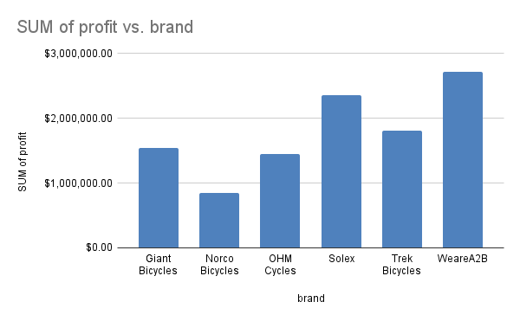
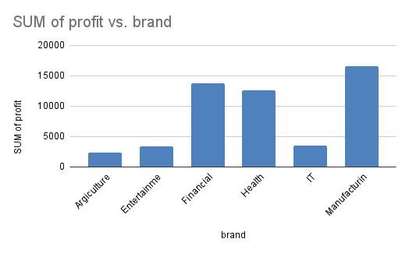
Data Exploration
`And the manufacturing industry take much of the credit, followed by Financial and Health
The product that brings the most profit is WeareA2B, solex, and Trek Bicycles

Slide 7
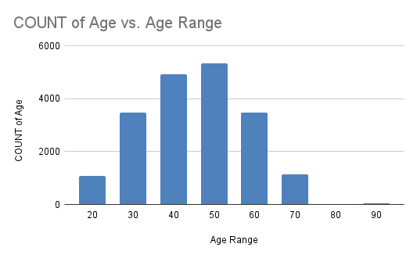
Data Exploration
Customers range from 20 to 90
The Age range that contribute most is 50, 40 and 60
And the least is 90 - which stands to reason

Slide 8
Note: The data and information in this document is reflective of a hypothetical situation and client. This document is to be used for KPMG Virtual Internship purposes only.
Model Development
RFM Analysis: To isolate customers based on level of recency, frequency and monetory
Customer Title | COUNT of RFM Value
Below-moderate | 1022
High-value Customers | 731
Losing Customers | 874
Moderate Customers | 866

Slide 9
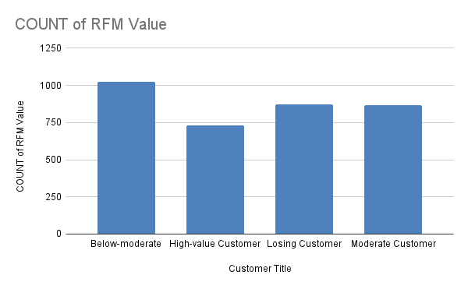
Note: The data and information in this document is reflective of a hypothetical situation and client. This document is to be used for KPMG Virtual Internship purposes only.
Model Development
RFM Analysis: To isolate customers based on level of recency, frequency and monetory
High-value customers denotes those with high rfm value
Although having high rfm value, their count are the least
Below-moderate Customers are the most customers
Place any supporting images, graphs, data or extra text here.

Slide 10
Note: The data and information in this document is reflective of a hypothetical situation and client. This document is to be used for KPMG Virtual Internship purposes only.
Interpretation
Recommendations for High-value Customers
High value customers should be targetted
They are in the Manufacturing and Health Industry
Age range of 50, 40, and 60

Slide 11
Note: The data and information in this document is reflective of a hypothetical situation and client. This document is to be used for KPMG Virtual Internship purposes only.
Appendix
This is an optional slide where you may place any supporting items.

